Slide 1

The Human Side of Cybersecurity

Slide 2


Slide 3

When it’s okay
to be vulnerable in cybersecurity

Slide 4

The Threat
Notes:
As with all things….

Slide 5
Numbers Don’t Lie
The average cost of a data breach was $4.24 million in 2021, the highest average on record. IBM
Personal data was involved in 45 percent of breaches in 2021. (Verizon)
94 percent of malware is delivered by email. (Verizon)
$17,700 is lost every minute due to a phishing attack. (CSO Online)
Worldwide cybercrime costs will hit $10.5 trillion annually by 2025. (Cybersecurity Ventures)

Slide 6

SOLUTION:
WE MUST BE VULNERABLE IN CYBERSECURITY
(The two-sided coin)

Slide 7
OUR VULNERABLE CYBER WORLD
Ransomware
Phishing Attacks
SQL Injection Attacks
Cross-Site Scripting
Man-in-the-Middle Attacks
Malware Attacks
Denial-of-Service Attacks
PII Breach
Spear Phishing Attacks
Whaling Phishing Attacks
Brute-Force Attacks
Dictionary Attacks
Lost/Stolen Assets
Insider Threats
Improper Usage

Slide 8
“The emotion we experience during times of uncertainty, risk, and emotional exposure.”
~Brene Brown
Vulnerability defined by science

Slide 9
“Vulnerability is not winning or losing.
It’s having the courage to show up when you can’t control the outcome.”
Brene brown

Slide 10
Our Cyber Charge:
Keep Being Courageous

Slide 11
“Courage is resistance to fear, mastery of fear,
NOT absence of fear.”
~Mark Twain
Courage Defined
Notes:
OR Another way to think about it:
“Courage is resistance to fear, mastery of fear, NOT absence of fear.” By Mark Twain
“What would life be if we had no courage to attempt anything?” Vincent Van Gogh
“I wanted you to see what real courage is, instead of getting the idea that courage is a man with a gun in his hand. It’s when you know you’re licked before you begin, but you begin anyway and see it through no matter what.”―Atticus Finch/Harper Lee, To Kill a Mockingbird

Slide 12

Cyber Courage is…to Keep Learning
Attend conferences
Network with different sectors and professional backgrounds
Understand those you don’t agree with (different perspectives
help us grow)
Apply best practices from business and personal growth
(not just cyber and technology practices)
Become proficient in psychology and behavior
Listen to Ted Talks and Podcasts
Read (or be read to)
Notes:
Be the idiot. “There is a lot of value being an idiot.” Simon Sinek

Slide 13

Cyber Courage is…to Share
Help those in your organization understand what you do and why by demystifying cybersecurity
Share with the RIGHT people inside AND outside your organization
Have boundaries when sharing. Remember that full disclosure is not vulnerable, it’s unwise (aka stupid)
Have empathy for those who are being courageous too – (it could have been you…)

Slide 14

Cyber Courage is…to Take Risks
Be innovative – “Creativity is thinking up new things. Innovation is doing new things.”
Be uncomfortable – If you are comfortable with all your cyber practices, you probably are not being that courageous.
Embrace your vendors - If you have vendors, you are already at risk. Embrace it and apply what you have learned.
Regulators are people too – they want your systems to be protected as much as you do; it is not “Us vs The Regulators;” It is “Our Industry vs. Bad Cyber Actors".

Slide 15
Join Me In The “Arena”

Slide 16
"It is not the critic who counts; not the man who points out how the strong man stumbles, or where the doer of deeds could have done them better. The credit belongs to the man who is actually in the arena, whose face is marred by dust and sweat and blood; who strives valiantly; who errs, who comes short again and again, because there is no effort without error and shortcoming; but who does actually strive to do the deeds; who knows great enthusiasms, the great devotions; who spends himself in a worthy cause; who at the best knows in the end the triumph of high achievement, and who at the worst, if he fails, at least fails while daring greatly, so that his place shall never be with those cold and timid souls who neither know victory nor defeat."
President
Theodore Roosevelt
Notes:
On April 23, 1910, Theodore Roosevelt gave what would become one of the most widely quoted speeches of his career. The former president—who left office in 1909—had spent a year hunting in Central Africa before embarking on a tour of Northern Africa and Europe in 1910, attending events and giving speeches in places like Cairo, Berlin, Naples, and Oxford. He stopped in Paris on April 23, and, at 3 p.m. at the Sorbonne, before a crowd that included, according to the Edmund Morris biography Colonel Roosevelt, “ministers in court dress, army and navy officers in full uniform, nine hundred students, and an audience of two thousand ticket holders,” Roosevelt delivered a speech called “Citizenship in a Republic,” which, among some, would come to be known as “The Man in the Arena.”
In addition to touching on his own family history, war, human and property rights, the responsibilities of citizenship, and France’s falling birthrate, Roosevelt railed against cynics who looked down at men who were trying to make the world a better place. “The poorest way to face life is to face it with a sneer,” he said. “A cynical habit of thought and speech, a readiness to criticize work which the critic himself never tries to perform, an intellectual aloofness which will not accept contact with life's realities—all these are marks, not ... of superiority but of weakness.”
Then he delivered an inspirational and impassioned message that drew huge applause:

Slide 17
The State’s “Arena”

Slide 18
INDIANA EXECUTIVE COUNCIL ON CYBERSECURITY MISSION
The IECC was continued through Governor Holcomb’s Executive Order 17-11 with the recognition that a cross-sector body of subject-matter experts is required to form an understanding of Indiana’s cyber risk profile, identify priorities, establish a strategic framework of Indiana’s cybersecurity initiatives, and leverage the body of talent to stay on the forefront of the cyber risk environment.

Slide 19
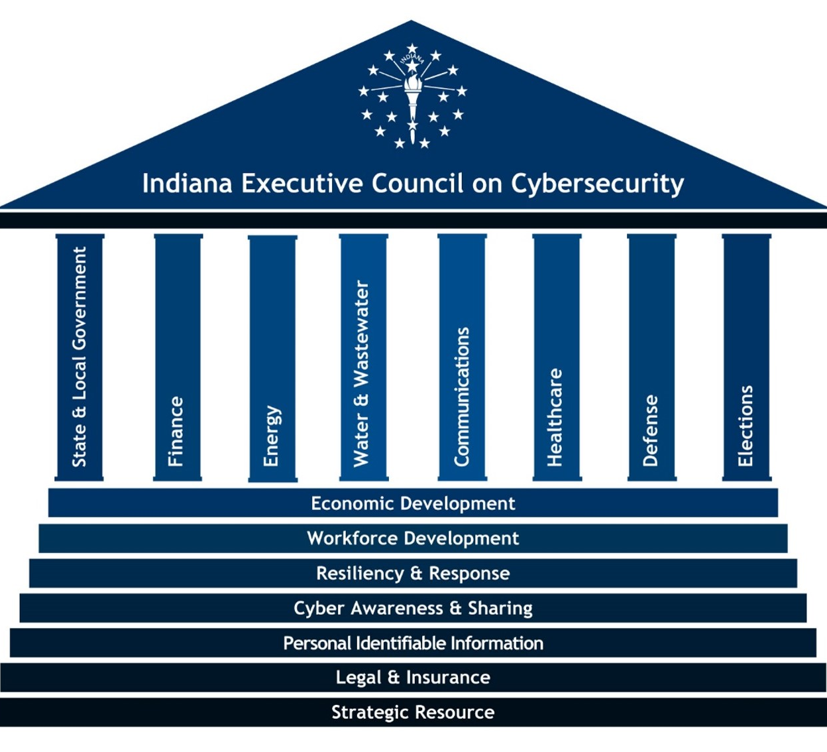
IECC BREAKDOWN
More than 250 courageous cyber warriors
15 teams; 1 Council
Completed Four Phases
  Research
  Planning
  Implementation
  Evaluation

Slide 20
Cybersecurity Hub Website

Slide 21
INDIANA CYBER HUB
Report a cyber crime
Sector-specific information
Strategic Plan
Events
Training
And More….

Slide 22
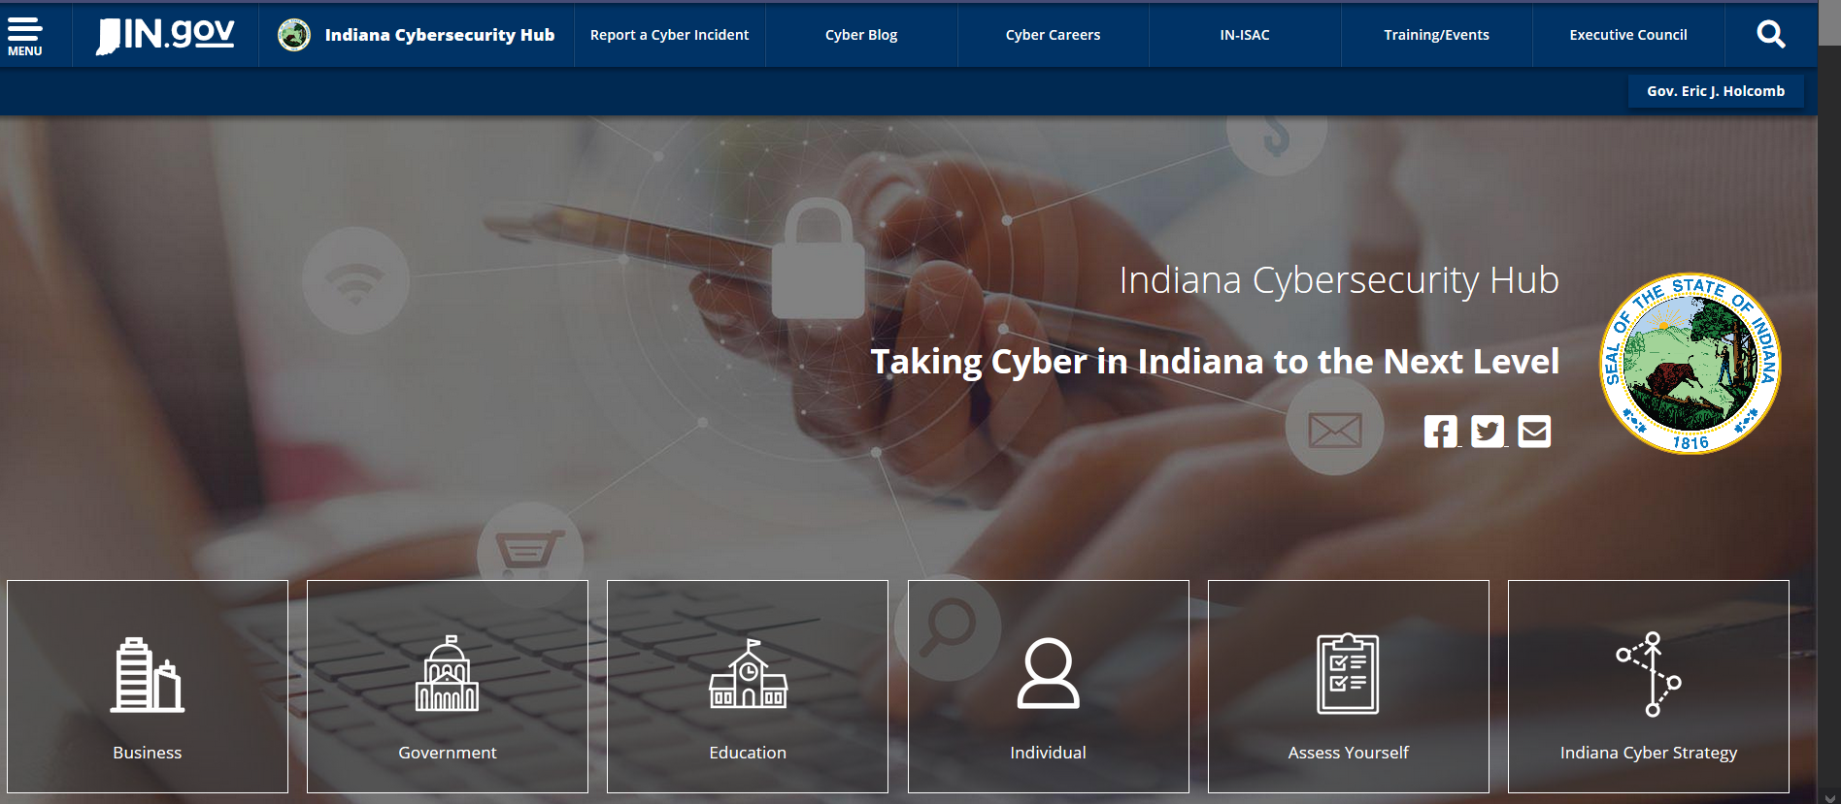
www.in.gov/cybersecurity

Slide 23

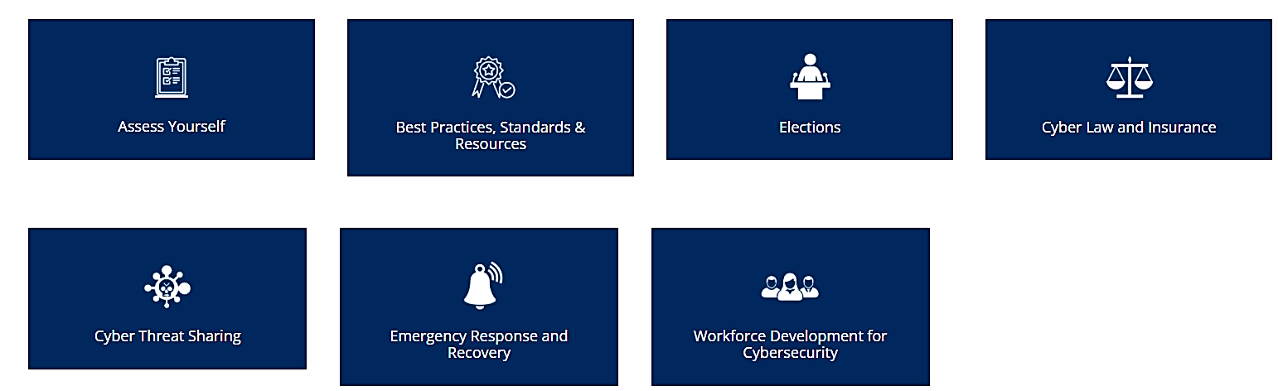
Notes:
Residents have entrusted their elected officials and government employees with important data.
This includes medical records, tax assessment data, property records, court records, personnel staffing records, criminal justice records, surveying records, and more. This is especially true for those governmental agencies that manage the utilities.
Like the previous business link, each of the icons on this page will take the user to follow-on pages that provide tools they need for assessments, view best practices, cyber laws and insurance, cyber threat sharing, emergency response and recovery information and workforce development for cybersecurity. This page has does have a unique section on elections and cybersecurity resources.

Slide 24
Emergency Cyber Response Resources

Slide 25

INDIANA CYBERSECURITY HUB HOME PAGE
CYBERSECURITY TOOLKIT LOCATIONS
Notes:
The next topic covers Emergency Response and Recovery. This is where the Emergency Manager Cybersecurity Toolkit is located. If you click on any of these three icons, you will see the following topic box (click next slide)

Slide 26


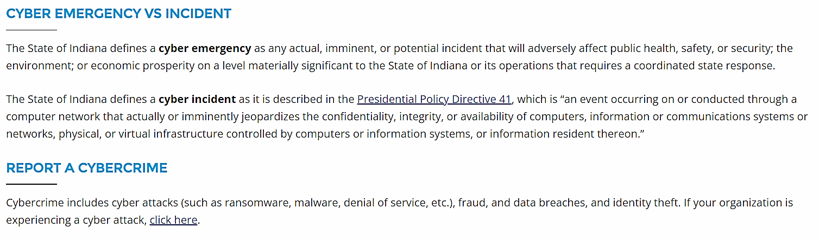
Notes:
Once you click on the Emergency Response and Recovery box, it will take you to this page. The top portion of the page provides an overview. This states determining which organizations should be involved and the roles they will play has proven challenging at all levels of government for nontraditional catastrophic emergencies such as a cyber attack.
This page provides links and information regarding a cyber emergency versus an incident and how to report a cybercrime.
In the center of the page is the Emergency Manager’s Cybersecurity Toolbox which I will show you in the next slide.

Slide 27

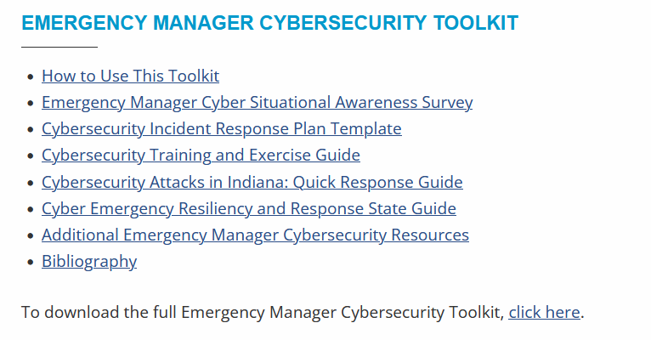
Emergency response and recovery
Notes:
Here are all the links to the Emergency Manager’s Cybersecurity Toolkit, which includes instructions for using the toolkit, an awareness survey, a cybersecurity incident response plan template, a cybersecurity training and exercise guide, a cyber resiliency and response state guide and additional resources. Next, I am going to briefly review the Cybersecurity Incident Response Planning Template.

Slide 28
Indiana Cybersecurity Hub
Indiana Cybersecurity
Notes:
When you visit the site, you will see 6 different icons

Slide 29
Cybersecurity Incident Response
Reporting a Cyber Crime
Step 1- Contact Law Enforcement.
  FBI Internet Crime Complaint Center (IC3)
  Indiana State Police (ISP)
  If lives are in danger call 911
Notes:
Here are some important quick response guides that you can follow, when it comes to reporting a Cyber crime.

Slide 30
Cybersecurity Incident Response
Reporting a Cyber Crime
Step 2- Additional Reporting
  Indiana Office of Technology (local govt entities)
  Indiana Attorney General
  USDHS CISA
  Regulators
  Secretary of State
Notes:
Here are some important quick response guides that you can follow, when it comes to reporting a Cyber crime.

Slide 31
Cybersecurity Incident Response
Reporting a Cyber Crime
Step 3- Utilize Additional Resources
  Department of Homeland Security’s Cybersecurity & Infrastructure Security Agency
  National Governors Association Response Planning Memo
  MS-ISAC
Notes:
Here are some important quick response guides that you can follow, when it comes to reporting a Cyber crime.

Slide 32
HEA 1169 REPORTING A CYBERSECURITY INCIDENT
THE INDIANA CYBERSECURITY LAW (HEA 1169) WENT INTO EFFECT ON JULY 1, 2021.
THE FOLLOWING GROUPS ARE REQUIRED, WITHIN 48 HOURS OF DISCOVERY TO REPORT CYBERSECURITY INCIDENTS TO THE INDIANA OFFICE OF TECHNOLOGY:
COUNTIES, MUNICIPALITIES, TOWNSHIPS, SCHOOL CORPORATIONS, LIBRARY DISTRICTS, LOCAL HOUSING AUTHORITIES, FIRE PROTECTION DISTRICTS, PUBLIC TRANSPORTATION CORPORATIONS, LOCAL BUILDING AUTHORITIES, LOCAL HOSPITAL AUTHORITIES OR CORPORATIONS, LOCAL AIRPORT AUTHORITIES, SPECIAL SERVICE DISTRICTS, SPECIAL TAXING DISTRICTS OR OTHER SEPARATE LOCAL GOVERNMENTAL ENTITIES THAT MAY SUE AND BE SUED.
Notes:
THE INDIANA CYBERSECURITY LAW (HEA 1169) WENT INTO EFFECT ON JULY 1, 2021.
The following groups are required, within 48 hours of discovery to report cybersecurity incidents to the Indiana Office of Technology:
Counties, municipalities, townships, school corporations, library districts, local housing authorities, fire protection districts, public transportation corporations, local building authorities, local hospital authorities or corporations, local airport authorities, special service districts, special taxing districts or other separate local governmental entities that may sue and be sued.

Slide 33
NEW RESOURCES COMING SOON!
HEALTHCARE CYBER IN A BOX TOOLKIT
UTILITY RESOURCE GUIDE
CYBER INSURANCE TOOLKIT
PRIVACY TOOLKIT
UPDATE TO EMERGENCY MANAGER TOOLKIT
NATIONAL POLICY STUDY OF ALL 50 STATE AND FEDERAL
UPDATE TO PII GUIDEBOOK
CYBER SHARING MATURITY MODEL

Slide 34
Thank You!
Chetrice mosley-Romero
Romeroclm@iot.in.gov
317-607-3178

Slide 35


CEU & SCHOLARSHIP ATTENDEES:
Attendees who would like to receive CEU credit or who are scholarship recipients, please scan the QR code OR visit the link below and fill out the online form.
https://www.midwest811conference.com/chetrice-mosley/

